Slide 1
Problem solving with non-linear relationships
Non-linear relationships

Slide 2
how to use Oak lessons

Slide 3
I can use my knowledge of non-linear relationships to solve problems.

Slide 4
A geometric sequence is a sequence with a constant multiplicative relationship between successive terms.
A triangular number (or triangle number) is a number that can be represented by a pattern of dots arranged into an equilateral triangle. The term number is the number of dots in a side of the triangle.
1
3
6
10
15

Slide 5

Problem solving with non-linear relationships
Problem solving with geometric relationships
Adding sequences

Slide 6
Problem solving with geometric sequences
The game of Chess was invented many, many years ago.
A story goes that the finished game was presented to a mean King who refused to share his vast stores of rice with the people despite there being a famine.
The King liked the game.
“What prize do you want for this wonderful game? You can have any reward you wish for” said the King.

Slide 7
Problem solving with geometric sequences
“I would like a single grain of rice on the first square of the board, two grains on the second square, four grains on the third, doubling each time ” said the inventor.
The King was startled at such a small price for such a wonderful game. He began to count out the rice.
1 | 2 | 4
How many grains will there be on the 64th square?

Slide 8
Problem solving with geometric sequences
1, 2, 4, 8, 16, 32, 64, 128,
1 | 2 | 4
256, 512, 1024, 2048, 4096, 8192, 16 384, 32 768,
1 | 2 | 4 | 8 | 16 | 32 | 64 | 128
65 536, 131 072, 262 144, …….. 8 388 608,
Over 8 million grains by the 24th square!
How many grains on the 64th square?

Slide 9
Problem solving with geometric sequences
Square | Grains | Rule
1 | 1 | 2⁰
2 | 2 | 2¹
3 | 4 | 2²
4 | 8 | 2³
5 | 16 | 2⁴
6 | 32 | 2⁵
Square | Grains | Rule
1 | 1
2 | 2
3 | 4
4 | 8
5 | 16
6 | 32
Square | Grains | Rule
1 | 1 | 2⁰
2 | 2 | 2¹
3 | 4 | 2²
4 | 8 | 2³
5 | 16 | 2⁴
6 | 32 | 2⁵
64
1 | 2 | 4 | 8 | 16 | 32 | 64 | 128
2⁶³
How many grains on the 64th square?

Slide 10
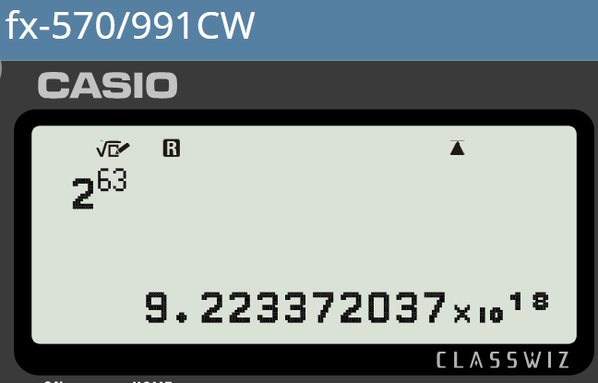
Problem solving with geometric sequences
There are 2⁶³ grains on the 64th square.
1 | 2 | 4 | 8 | 16 | 32 | 64 | 128
To 1 s.f. that’s 9 × 10¹⁸
Or… 9 000 000 000 000 000 000
Which is the number nine quintillion!
The King was unable to pay his debt.
Even the King did not have this much rice.
This story is a good example of the power of geometric sequences and also the limitations of using this element of mathematics in modelling.

Slide 11


Problem solving with geometric sequences
We might see the very same numbers and pattern in a very different context.
There are 2 thousand penguins living on an island. Every decade their population doubles.
Decade | Pop (000’s)
1 | 2
2
3
4
5
6

Slide 12
Problem solving with geometric sequences
We might see the very same numbers and pattern in a very different context.
There are 2 thousand penguins living on an island. Every decade their population doubles.
Decade | Pop (000’s)
1 | 2
2
3
4
5
6
Decade | Pop (000’s)
1 | 2
2 | 4
3
4
5
6
Decade | Pop (000’s)
1 | 2
2 | 4
3 | 8
4
5
6
Decade | Pop (000’s)
1 | 2
2 | 4
3 | 8
4 | 16
5
6

Slide 13
Problem solving with geometric sequences
We might see the very same numbers and pattern in a very different context.
There are 2 thousand penguins living on an island. Every decade their population doubles.
Decade | Pop (000’s)
1 | 2
2 | 4
3 | 8
4 | 16
5 | 32
6

Slide 14
Problem solving with geometric sequences
We might see the very same numbers and pattern in a very different context.
There are 2 thousand penguins living on an island. Every decade their population doubles.
Decade | Pop (000’s)
1 | 2
2 | 4
3 | 8
4 | 16
5 | 32
6 | 64

Slide 15
Problem solving with geometric sequences
We might see the very same numbers and pattern in a very different context.
There are 2 thousand penguins living on an island. Every decade their population doubles.
Can you see a problem?
The island will run out of space. The waters will run out of food locally. When penguins have to swim further for food they spend more time in the water with their predators. This will naturally limit the population on this island.

Slide 16
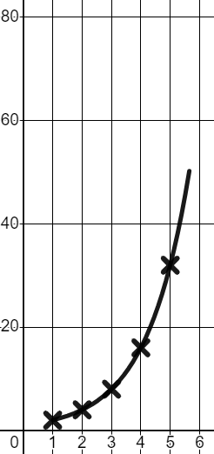
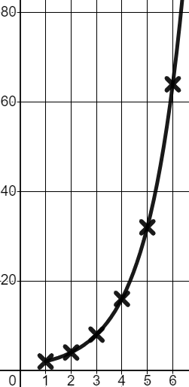
Problem solving with geometric sequences
A geometric sequence can be graphed, and this growth model might be accurate to a point…
But, there would be a natural limit.
Decade | Pop (000’s)
1 | 2
2 | 4
3 | 8
4 | 16
5 | 32
6 | 64
Growth cannot be endless; the line would flatten out somewhere.
Pop (000’s)
Decade

Slide 17

Problem solving with geometric sequences
When the sun comes out in the Spring flowers grow very quickly.
This flower’s height is following a geometric pattern.
Week | Height (cm)
1 | 1
2 | 3
3 | 9
4
What could we assume the flower’s height will be next week?
What problems do you foresee with this growth model?

Slide 18
Problem solving with geometric sequences
When the sun comes out in the Spring flowers grow very quickly.
This flower’s height is following a geometric pattern.
Week | Height (cm)
1 | 1
2 | 3
3 | 9
4
Week | Height (cm)
1 | 1
2 | 3
3 | 9
4 | 27
×3
What could we assume the flower’s height will be next week?
What problems do you foresee with this growth model?
×3
×3

Slide 19
Problem solving with geometric sequences
When the sun comes out in the Spring flowers grow very quickly.
This flower’s height is following a geometric pattern.
Week | Height (cm)
1 | 1
2 | 3
3 | 9
4 | 27
5 | 81
6 | 243
7 | 729
8 | 2187
Week | Height (cm)
1 | 1
2 | 3
3 | 9
4 | 27
×3
What could we assume the flower’s height will be next week?
What problems do you foresee with this growth model?
×3
×3
Growth is not usually endless. This model will have a natural limit.
Most flowers don’t grow to 20 m tall!

Slide 20
Problem solving with geometric sequences
1) Passing information is another thing which can form a geometric sequence. The bus is going to be late back from a school trip. One pupil phones their parent. The parent phones 5 other parents. Each of those parents phone 5 other parents. Assume it takes 10 minutes to make 5 phone calls.
a) How many people would know after 40 mins?
b) Why might this not be realistic?
c) How many people would know after 2 hours?
d) Why might this not be realistic?
Time | People
10 mins | 5
20 mins | 25
(plus the one parent who initially knew)

Slide 21
Problem solving with geometric sequences
1) Passing information is another thing which can form a geometric sequence. The bus is going to be late back from a school trip. One pupil phones their parent. The parent phones 5 other parents. Each of those parents phone 5 other parents. Assume it takes 5 minutes to make a phone call.
a) How many people would know after 40 mins?
Time | People
10 mins | 5
20 mins | 25
30 mins | 125
626 people would know if the growth continued at the above rate.
Time | People
10 mins | 5
20 mins | 25
30 mins | 125
40 mins | 625 + 1
×5
b) Why might this not be realistic?
×5
×5
Some parents might ring the same people. Some parents might not ring anyone.
It might take some parents longer than 10 minutes to ring 5 parents.

Slide 22
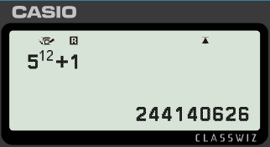
Problem solving with geometric sequences
1) Passing information is another thing which can form a geometric sequence. The bus is going to be late back from a school trip. One pupil phones their parent. The parent phones 5 other parents. Each of those parents phone 5 other parents. Assume it takes 5 minutes to make a phone call.
c) How many people would know after 2 hours?
Time | People
10 mins
20 mins
30 mins
40 mins
50 mins
60 mins
120 mins
Time | People
10 mins | 5
20 mins | 25
30 mins | 125
40 mins | 625
50 mins | 3125
60 mins | 15 625
70 mins | 78 125
5
5²
≈ 200 000 000 people
5³
5⁴
d) Why might this not be realistic?
5⁵
5⁶
There will not be that many parents to tell.
5¹²

Slide 23
Problem solving with non-linear relationships
Problem solving with geometric relationships
Adding sequences

Slide 24
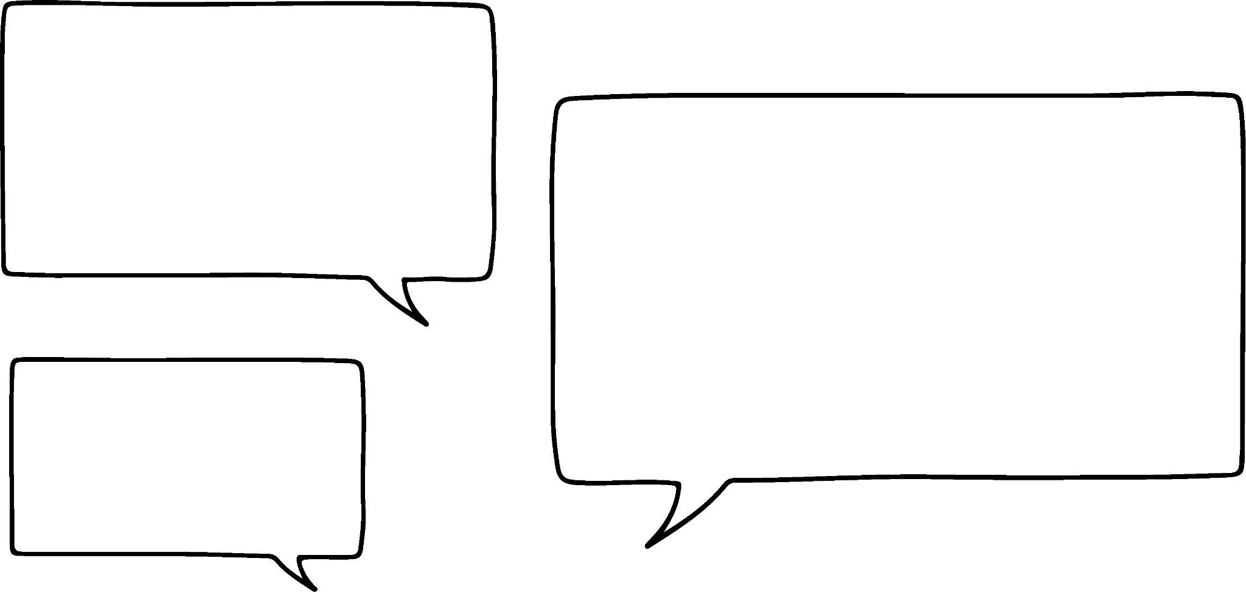

Adding sequences
Sometimes adding two different sequences together can provide interesting results.
We are going to investigate this idea in this part of the lesson.
I think adding two arithmetic sequences together will give a different arithmetic sequence.
What do you think?
Sofia
Example 3, 5, 7, 9, 11, …. added to 4, 7, 10, 13, 16, ….
7, 12, 17, 22, 27, …. This is an arithmetic sequence with common difference +7
Try your own example.

Slide 25
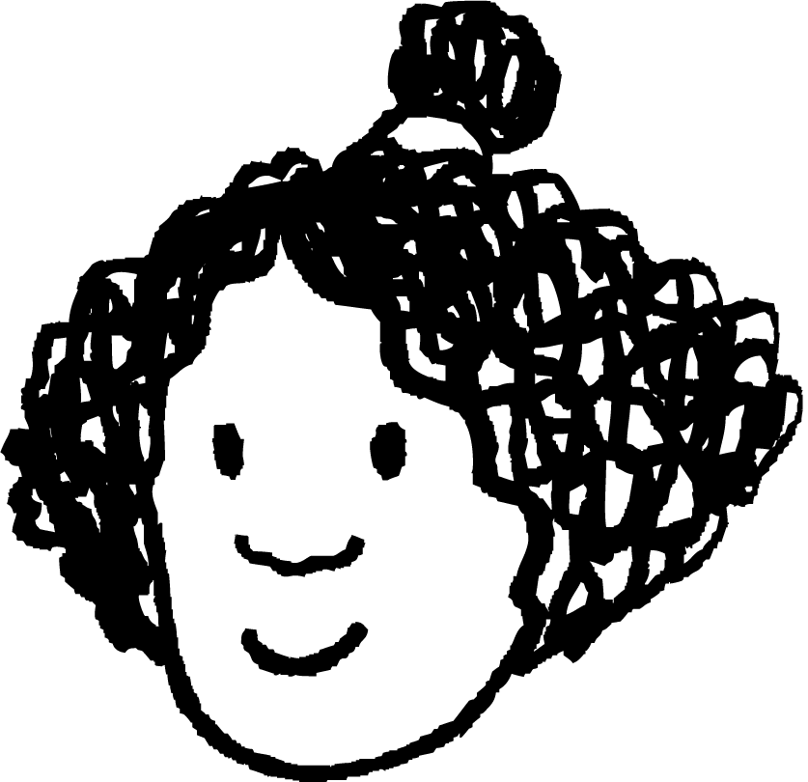
Adding sequences
Sofia is correct for this example, will this always work?
Let’s try with an increasing and a decreasing sequence.
E.g. 5, 8, 11, 14, … add 10, 8, 6, 4, …
15, 16, 17, 18, … We have an arithmetic sequence with common difference 1.
Izzy
We have only tried two examples so we cannot say for sure that this always works. Even if we tried 100 examples, this would not be proof that this always works.
Instead we can explore the structure of what is happening when we add the terms of two sequences together.

Slide 26

Adding sequences
What are the n^{th} term rules for these linear sequences?
3, 5, 7, 9, 11, …. and 4, 7, 10, 13, 16, ….
2n + 1 and 3n + 1
To find any number in the sequences added together you would apply the rule 2n + 1 and then add the value of 3n + 1
2n + 1 + 3n + 1 can be simplified by collecting like terms.
5n + 2
The new sequence 7, 12, 17, 22, …. should have n^{th} term rule 5n + 2 which would make it a linear sequence. Check this is true.

Slide 27
Adding sequences
So adding two sequences together means we can add their n^{th} term rules to get the rule for the new sequence.
Adding two linear expressions will give another linear expression. You can prove this using algebra if you wish.
What about if we add two quadratic sequences together?
A quadratic sequence has a linear relationship in the differences between terms.
E.g. add 2, add 4, add 6, add 8, …
We can say they have a common second difference.
Sofia
What do you think will happen?
Try an example.

Slide 28

Adding sequences
2, 6, 12, 20, 30, … is a quadratic sequence with common second difference +2
+4
+6
+8
+10
5, 6, 8, 11, 15, … is a quadratic sequence with common second difference +1
+1
+2
+3
+4
When we add them together we get: 7, 12, 20, 31, 45, …
+5
+8
+11
+14
+3
+3
+3
We have another quadratic sequence with common second difference +3
We are not able to explore this algebraically without knowing the n^{th} term rules however we can try more examples.

Slide 29
Adding sequences
The square numbers form a quadratic sequence when written in numerical order.
The triangle numbers do too!
Sofia
Izzy
1) Write the first five terms of the sequence of square numbers in ascending order.
2) Write the first five terms of the sequence of triangle numbers in ascending order.
3) Add your sequences together (the sum of the first terms of each make the first term of your new sequence etc.), what do you notice about this new sequence?

Slide 30
Adding sequences
The square numbers form a quadratic sequence when written in numerical order.
The triangle numbers do too!
Sofia
Izzy
1) Write the first five terms of the sequence of square numbers in ascending order 1, 4, 9, 16, 25, …
2) Write the first five terms of the sequence of triangle numbers in ascending order 1, 3, 6, 10, 15, …
3) Add your sequences together, what do you notice about this new sequence? 2, 7, 15, 26, 40, …

Slide 31
Adding sequences
The square numbers form a quadratic sequence when written in numerical order.
The triangle numbers do too!
Sofia
Izzy
3) Add your sequences together, what do you notice about this new sequence? 2, 7, 15, 26, 40, …
+5
+8
+11
+14
+3
+3
+3
It is also a quadratic sequence. It increases by 5, then 8, then 11, then 14…
It has a common second difference of 3

Slide 32
Adding sequences
1) In each question, the sequences were created by adding the terms of two of the sequences given below. Work out which two sequences were added in each question.
A
1, 2, 4, 8, 16 …
B
4, 12, 36, 108, …
C
4, 9, 14, 19, …
D
1, 3, 5, 7, 9 …
E
4, 7, 12, 19, …
F
1, 6, 16, 31, 51, …
G
4, 6, 6, 4, 0 …
H
1, 8, 27, 64, …
a) 5, 12, 19, 26, 33, …
b) 5, 11, 18, 27, 40, …
c) 5, 13, 28, 50, 79, …
d) 2, 9, 21, 38, 60, …
e) 2, 5, 9, 15, 25, …
f) 2, 11, 32, 71, 134, …
g) 5, 14, 40, 127, 356, …
h) 8, 15, 20, 23, 24, …
i) 8, 13, 18, 23, 28, …
2) What is the n^{th} term rule for sequence a). How does that relate to the two sequences you have chosen for your answer to a)?

Slide 33
Adding sequences
3) By using the examples previously and any of your own examples, investigate the following questions and write a sentence about any patterns you have noticed.
a) What happens when you add two geometric sequences together?
b) What happens when you add two quadratic sequences together?
(square and triangle numbers are examples of quadratic sequences)
c) What happens when you add a linear sequence to a geometric sequence?
d) What happens when you add a linear sequence to a quadratic sequence?

Slide 34
Adding sequences
1) In each question, the sequences were created by adding the terms of two of the sequences given below. Work out which two sequences were added in each question.
A
1, 2, 4, 8, 16 …
B
4, 12, 36, 108, …
C
4, 9, 14, 19, …
D
1, 3, 5, 7, 9 …
E
4, 7, 12, 19, …
F
1, 6, 16, 31, 51, …
G
4, 6, 6, 4, 0 …
H
1, 8, 27, 64, …
a) 5, 12, 19, 26, 33, … C + D
b) 5, 11, 18, 27, 40, … A + C
c) 5, 13, 28, 50, 79, … E + F
d) 2, 9, 21, 38, 60, … D + F
e) 2, 5, 9, 15, 25, … A + D
f) 2, 11, 32, 71, 134, … D + H

Slide 35
Adding sequences
1) In each question, the sequences were created by adding the terms of two of the sequences given below. Work out which two sequences were added in each question.
A
1, 2, 4, 8, 16 …
B
4, 12, 36, 108, …
C
4, 9, 14, 19, …
D
1, 3, 5, 7, 9 …
E
4, 7, 12, 19, …
F
1, 6, 16, 31, 51, …
G
4, 6, 6, 4, 0 …
H
1, 8, 27, 64, …
g) 5, 14, 40, 127, 356, … A + B
h) 8, 15, 20, 23, 24, … C + G
i) 8, 13, 18, 23, 28, … E + G
2) What is the n^{th} term rule for sequence a). How does that relate to the two sequences you have chosen for your answer to a)?
7n − 2. The n^{th} term rules for C and D are 5n − 1 and 2n − 1. Adding the n^{th} terms together: 5n−1 + 2n − 1 = 7n − 2.

Slide 36
Adding sequences
3) By using the examples previously and any of your own examples, investigate the following questions and write a sentence about any patterns you have noticed.
a) What happens when you add two geometric sequences together?
b) What happens when you add two quadratic sequences together?
E.g. You do not get another geometric sequence. There is no clear arithmetic or geometric pattern in the differences or ratios between terms.
E.g. Often you get another quadratic sequence with the common second difference of the new sequence equal to the sum of the second differences of the original sequences. If the second differences of two sequences are the additive inverses of each other it is possible to add two quadratic sequences to get a linear sequence- Question 1i) is an example of this.

Slide 37
Adding sequences
3) By using the examples previously and any of your own examples, investigate the following questions and write a sentence about any patterns you have noticed.
c) What happens when you add a linear sequence to a geometric sequence?
d) What happens when you add a linear sequence to a quadratic sequence?
E.g. The resulting sequences are neither arithmetic or geometric. There seems to be geometric relationships in the second differences between terms.
E.g. You will get a quadratic sequence. If you knew the n^{th} term rules, adding them together would give you the new n^{th} term rule.

Slide 38
Problem solving with non-linear relationships
If you can spot a sequence it is possible to predict behaviour.
Applying mathematical modelling to real life situations has its limitations.
Sequences can be built by adding other sequences together. The n^{th} term rules can be added together to get the rule for the new sequence.
Sequences can help us solve mathematical problems.
There are problems in mathematics that are ongoing which mathematicians are working to figure out.

Slide 39

© Oak National Academy 2024.
Produced in partnership with Mathematics in Education and Industry.
Licensed on the Open Government Licence v3.0, except where otherwise stated. See Oak terms and conditions.

